Slide 1
FS Autism Hackathon '26
Financial Services Autism Hackathon 2026 - Use Case #2
Empowering Autism Care: AI-Assisted Program Development
Personalizing care for individuals with autism through historical data insights.

Slide 2


Use Case #2: AI Assisted Program Development and Summarization
Leveraging historical data creates a foundation for personalized, lifelong autism support.
By synthesizing comprehensive individual histories—from early diagnostic evaluations to educational milestones—we build a narrative of growth and potential.
Our AI-driven approach ensures that every transition is supported by a deep understanding of unique needs and previous successes.
Synthesizing Historical Data
Comprehensive individual histories.
Utilizing Diagnostic Reports
Critical medical and clinical evaluations.
Integrating IEPs
Understanding educational needs and goals.
Tailored Programs
Personalized, lifelong support foundation.

Slide 3
AI Assisted Program Development and Summarization
This use case centers on building a secure, personalized AI foundation by leveraging a mountain of an individual's historical data, such as diagnostic reports, psychoeducational evaluations, and IEPs 2. The goal is to use multi-model and agentic support to tailor highly unique programs that improve individual outcomes over a lifetime.

Slide 4

FS Autism Hackathon '26
Agentic and Multi-Model AI Collaborate to Synthesize Complex Data into Unique Care Programs
Multi-Model AI
Processing diverse historical and current data, including text, diagnostic images, and behavioral assessments.
Agentic Support
Providing autonomous assistance to analyze and connect complex information across disparate datasets.
Program Synthesis
The engine synthesizes all processed data into completely unique, individualized care programs for every learner.

Slide 5



Continuous AI adaptation improves individual longitudinal outcomes over a lifetime.
Continuous Adaptation
Care programs that evolve alongside the individual as they grow and their needs change.
Lifelong Support
Moving beyond short-term fixes to focus on the entire lifespan.
Improved Outcomes
Dedicated to enhancing longitudinal outcomes through tailored, responsive care.

Slide 6


FS Autism Hackathon '26
A secure environment for sensitive medical and educational data is our foundation of trust.
Foundation of Trust
Prioritizing a secure environment above all else to protect families and foster a sense of safety.
Data Privacy & Standards
Strict adherence to industry privacy standards, including HIPAA-like security protocols and rigorous access controls.
Protecting Sensitive Records
Advanced safeguarding of personal medical records, clinical evaluations, and individual educational data.
Secure Environment

Slide 7
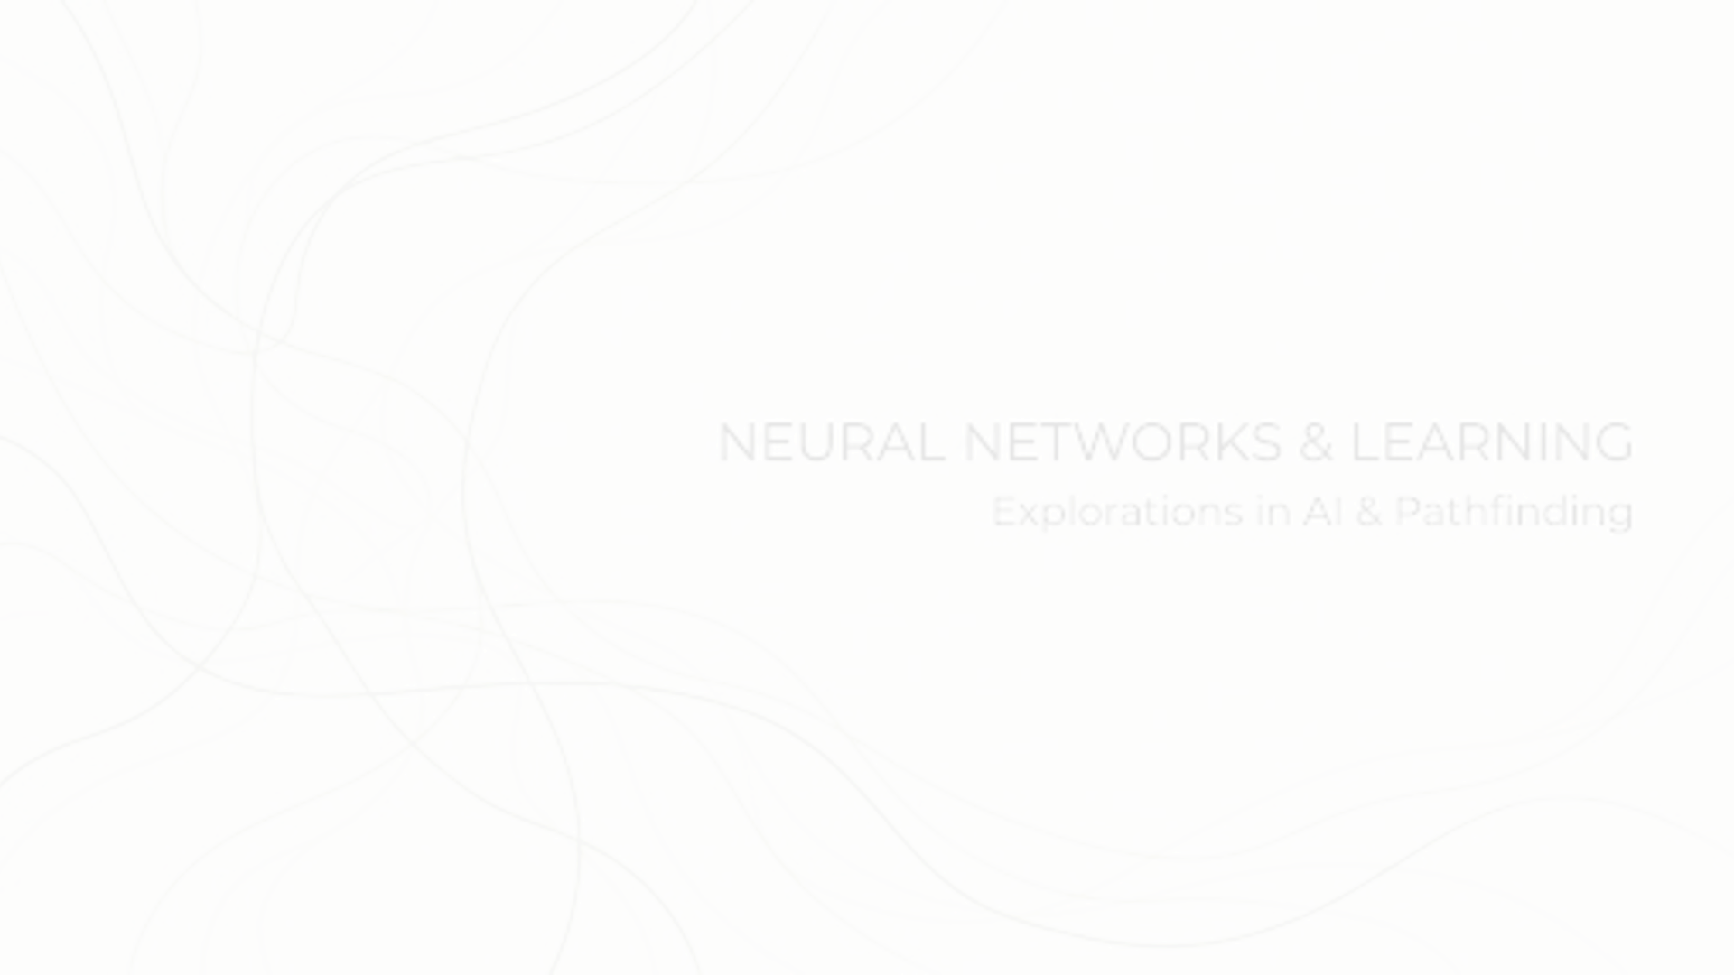
FS Autism Hackathon '26
Architectural Paths for AI-Assis
Showcasing frameworks to balance speed, analytical scale, customizability, and rapid zero-code synthesis for hackathon evaluations.

Slide 8



FS Autism Hackathon '26
Data Ingestion Layer
The foundation of all four architectures is a robust ingestion layer, designed to handle diverse clinical inputs ranging from flat PDFs to relational structures.
GCS / BigQuery
Handles relational tables (e.g., WISC score indexes) and flat evaluation PDFs.
Direct Drag-and-Drop
Enables immediate local patient PDF uploads for fast testing.

Slide 9




FS Autism Hackathon '26
The Four Architectures
Choose the right deployment path based on your team's optimization goals and technical expertise.
Option 1: NotebookLM
Zero-code document RAG and Audio podcast generation for instant synthesis.
Option 2: Gemini Enterprise App
GUI-first search app. Fast deployment with guided logic.
Option 3: BigQuery Notebook
RAG & Gemini text-synthesis operating at massive scale inside BigQuery.
Option 4: GEAP + ADK
Python-native Agent Runtime optimized for highly custom deployments and evals.

Slide 10
FS Autism Hackathon '26
Architecture Comparison
Option
Architecture Path
Speed
Customizability
Primary Use Case
1
NotebookLM
Instant
Low
Zero-code document synthesis
2
GE App
Fast
Medium
Managed RAG
3
BigQuery
Moderate
High
High-scale batch synthesis
4
GEAP + ADK
Slower
Maximum
Custom Python-native agents

